Slide 1
Santhosh L
Final Project
3/21/2024 Annual Review

Slide 2
CHARACTER AND DIGIT RECOGNITION
3/21/2024 Annual Review

Slide 3


AGENDA Introduction to Character and Digit Recognition Project Current State of Character and Digit Recognition Technology Objectives of the Project Methodology and Approach Timeline and Milestones Resources Required Potential Challenges Conclusion and Next Steps
3/21/2024 Annual Review

Slide 4

PROBLEM STATEMENT Character and digit recognition involve the identification and classification of alphanumeric characters and digits from various sources such as handwritten text, printed documents, or digital images. The problem arises due to the inherent complexity of handwritten characters, variations in writing styles, and noise in images. Traditional methods often struggle with accuracy and efficiency in recognizing characters and digits accurately, especially in real-world scenarios where variability is high. Therefore, the aim of this project is to develop a robust and accurate character and digit recognition system that can handle various input sources and deliver high-performance results consistently.
3/21/2024 Annual Review

Slide 5

PROJECT OVERVIEW The character and digit recognition project aim to develop an advanced system capable of accurately identifying and classifying alphanumeric characters and digits from diverse sources. The key components of the project include: Data Collection: Gathering a diverse dataset of handwritten and printed characters and digits. Preprocessing: Cleaning and standardizing the data to remove noise and enhance readability. Feature Extraction: Extracting relevant features from the input images to facilitate pattern recognition. Model Training: Training machine learning models, such as convolutional neural networks (CNNs) or recurrent neural networks (RNNs), on the labeled dataset to learn the patterns associated with different characters and digits. Evaluation: Assessing the performance of the trained models using various metrics such as accuracy, precision, recall, and F1 score.
3/21/2024 Annual Review

Slide 6

WHO ARE THE END USERS? Document Processing Companies: These companies often deal with large volumes of documents that need to be digitized and processed. End users in this context could be data entry operators, administrative staff, or professionals in fields such as finance, legal, or healthcare who rely on accurate and efficient digitization of documents. Financial Institutions: Banks, insurance companies, and other financial institutions may use character and digit recognition systems for tasks such as reading checks, processing invoices, or verifying signatures. End users could include banking staff, accountants, or fraud detection specialists who require accurate data extraction and processing. Retail and E-commerce Companies: Retailers and e-commerce platforms may use character and digit recognition for tasks such as reading product labels, processing shipping documents, or recognizing handwritten customer information. End users could include warehouse staff, logistics coordinators, or customer service representatives who need accurate and timely data for order fulfillment and customer support.
3/21/2024 Annual Review

Slide 7

YOUR SOLUTION AND ITS VALUE PROPOSITION Robust Data Collection: We gather a diverse dataset of characters and digits, encompassing various fonts, styles, and writing variations to train our models effectively. Advanced Preprocessing: We employ advanced preprocessing techniques to clean and standardize the data, removing noise and enhancing the readability of characters and digits. Feature Extraction: Our system extracts relevant features from the input images, enabling effective pattern recognition and classification. Machine Learning Models: We train sophisticated machine learning models, such as convolutional neural networks (CNNs) and recurrent neural networks (RNNs), on the labeled dataset to learn the intricate patterns associated with different characters and digits. Continuous Improvement: We continuously optimize our models and algorithms to improve performance, accuracy, and efficiency over time. Scalable Deployment: Our solution is designed to be scalable and deployable across various platforms, including desktop applications, web services, and mobile devices, ensuring accessibility and usability for a wide range of users.

Slide 8

THE WOW IN YOUR SOLUTION Cutting-Edge Accuracy: Our solution doesn't just aim for accuracy; it achieves unparalleled precision in character and digit recognition. By harnessing the latest advancements in machine learning and computer vision, we've pushed the boundaries to deliver results that consistently astound users with their precision and reliability. Instantaneous Speed: Imagine processing vast volumes of documents or images in mere moments. Our solution operates at lightning speed, swiftly analyzing and recognizing characters and digits in real-time. Users are left in awe as they witness the rapid transformation of cumbersome manual tasks into lightning-fast automated processes. Adaptability Beyond Expectations: Whether it's deciphering handwritten notes, decoding intricate fonts, or parsing through complex data, our solution adapts effortlessly to any challenge thrown its way. Its versatility knows no bounds, impressing users with its ability to handle diverse inputs with ease and accuracy.
3/21/2024 Annual Review
8

Slide 9
MODELLING
Modeling for character and digit recognition involves designing and training machine learning models capable of accurately identifying and classifying alphanumeric characters and digits from various sources.
Data Collection and Preprocessing
Feature Extraction
Model Selection
Model Training
Evaluation
Deployment
Continuous Improvement
9

Slide 10
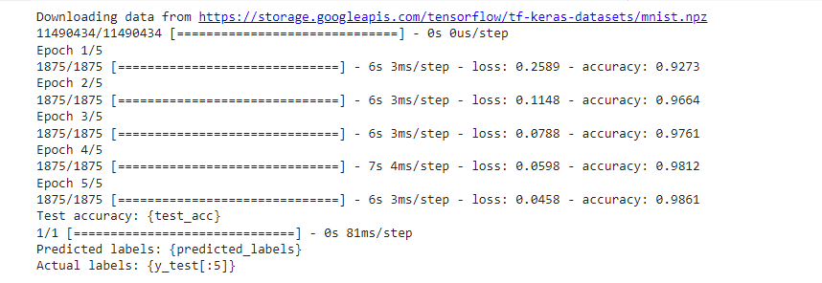
RESULTS The result of character and digit recognition is the accurate identification and classification of alphanumeric characters and digits from various sources, such as handwritten text, printed documents, or digital images. The output typically includes the recognized characters and digits, along with any additional information such as confidence scores or bounding boxes.
10

